Slide 1
CREDIT EDA CASE STUDY
Group FACILitator name: Ankit gupta
Group Member Name : vishwantra sharma

Slide 2
Case Study details and problem
A consumer finance company which specialises in lending various types of loans to urban customers. The company receives loan application, the approval of loan application based on applicant's profile. There are two links associated with the bank's decision:
If the applicant is likely to repay the loan, then not approving the loan results in a loss of business to the company.
If the applicant is not likely to repay the loan, i.e. he/she is likely to default, then approving the loan may lead to a financial loss for the company.
We use EDA to analyse the patterns present in the data to ensure that the applicants capable of repaying the loan are not rejected by the company.
OBJECTIVES OF THE CASE STUDY
To identify patterns which indicate if a client has difficulty paying their installments which may be used for taking actions such as denying the loan, reducing the amount of loan, lending (to risky applicants) at a higher interest rate, etc.
To understand the driving factors (or driver variables) behind loan default, i.e. the variables which are strong indicators of default.

Slide 3
FILES USED AND APPROACH
DATA FILE USED FOR EDA
We have been provided with two data files for this case study.
application_data
previous_application_data

Slide 4
FILES USED AND APPROACH
We have been provided with two data files for this case study.
application_data
previous_application_data
APPROACH USED
CLEANING THE DATA- Here we drop columns with missing values, convert numerical values to int, float type.
UNIVARIATE ANALYSIS- We check the distribution and frequency of the continuous and categorical variable.
SEGMENTED UNIVARIATE ANALYSIS- We analyzed variables against segments of other variables.
BIVARIATE ANALYSIS- We do bivariate to find the correlation and trends between the different variables
SUMMARIZATION-Give insights for every plots and final recommendation.

Slide 5
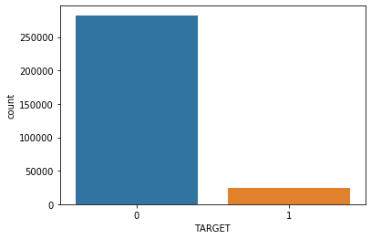
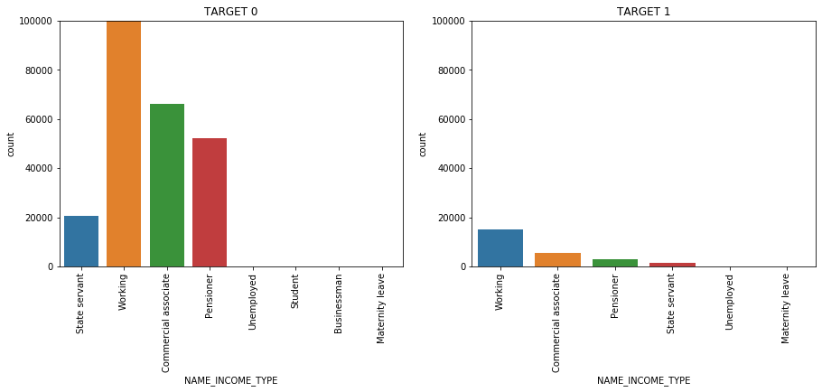
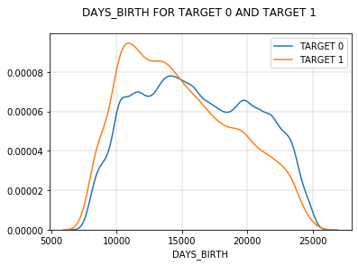
Application Data:
After cleaning up the data the data is divide into two categories:
Target_0 (i.e. Non-Defaulters)
Target_1 (i,.e. Defaulters)
Ratio of Non-Defaulters and Defaulters is 92:8(approx.)
Univariate Analysis:
The plot clearly shows that working are most likely to make payment on time which is true only the person who is earning will return the credit whereas unemployed, student are less likely to make payment on time.
From the above plot, we can clearly see that people within the range age 20-30 are less likely to pay loan on time while this ratio decreases with increasing age.

Slide 6
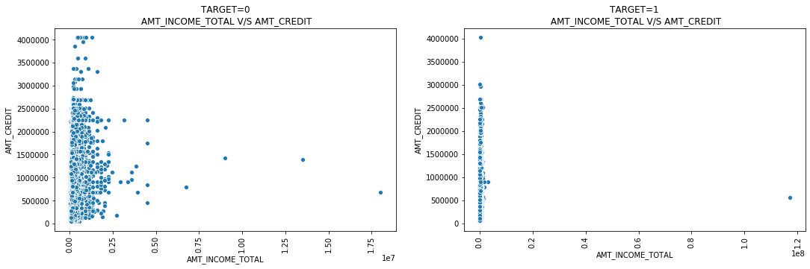
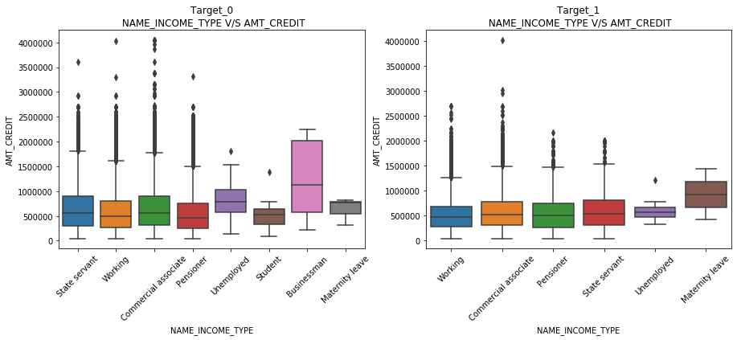
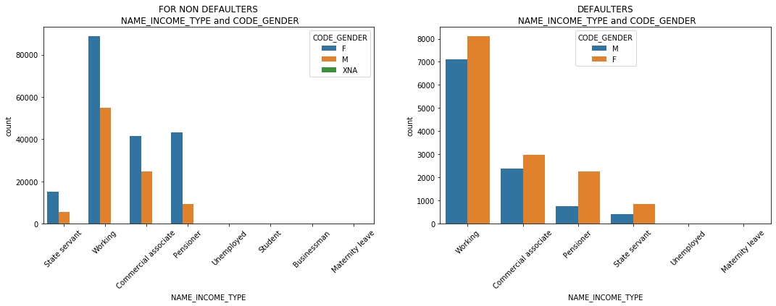
Application Data:
Bivariate Analysis:
For Continuous-Continuous variable
Those who have paid the loan amount on/within time are more likely to get higher credits than those who did not pay/did late payments.
For Continuous-Categorical variable
From the above plot it is clear that amount annuity is very high for businessman where as very low for the student also these two do not comes under the target_1.
For Categorical-Categorical variable
From the above plots we can clearly seen that the count of working client is higher than the other category, followed by pensioners in non defaulter case but for defaulters plots it is followed by commercial associate.

Slide 7
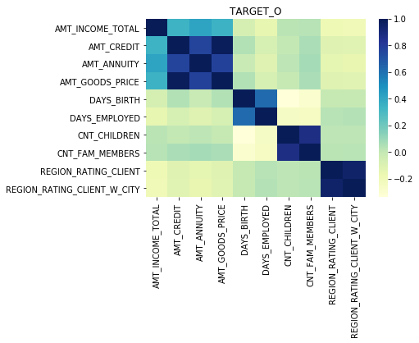
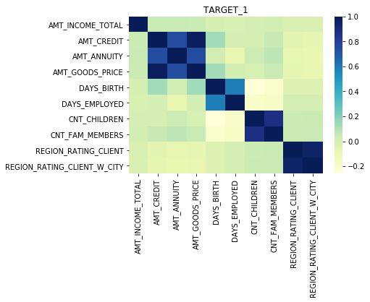
Correlation Analysis:
From the correlation tables and heat map we can clearly see that correlation between the variables is same for both the data frames target_0 and target_1. Also we had negative correlation between CNT_CHILDREN and DAYS_BIRTH and a very nice positive correlation between AMT_CREDIT and AMT_GOODS_PRICE.

Slide 8
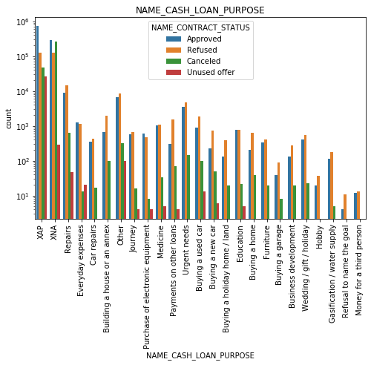
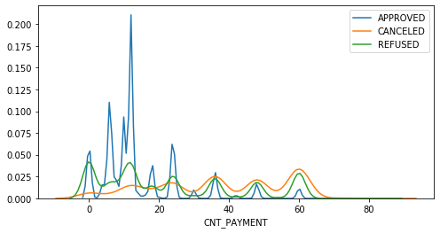
Previous Application Data:
Univariate Analysis:
For categorical variable
Refusal rate is high as compared to other for most of the purposes except a few like purchase of electronic equipment, here the approval rate is high.
For education purposes we have equal number of approval and refusal.
Refusal is almost double when name of the goal is not mentioned.
Paying other loans and buying a new car is having significant higher refusal than approval.
For continuous variable
From the above plot, we can see that approval application count is for the range (5-30) after this when count of payment increases cancellation and refusal count also increases compared to approval.

Slide 9
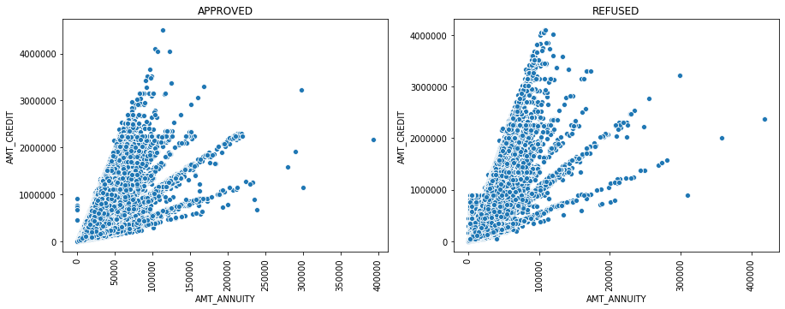
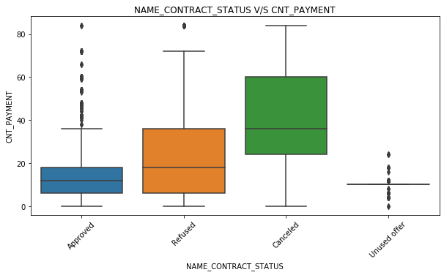
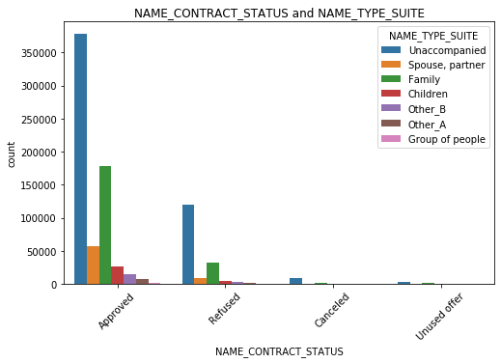
Previous Application Data:
Bivariate Analysis:
For Continuous-Continuous variable
This graph also shows a positive correlation between the variables, as the increase in AMT_CREDIT also results in increase of AMT_ANNUITY.
For Continuous-Categorical variable
From the above plot we can clearly see that if the count of payment increases, the chance of refusal and cancellation of application also increases.
For Categorical-Categorical variable
From the above plot, we can easily visualize that approval of loan do not need any accompanied person with them.

Slide 10
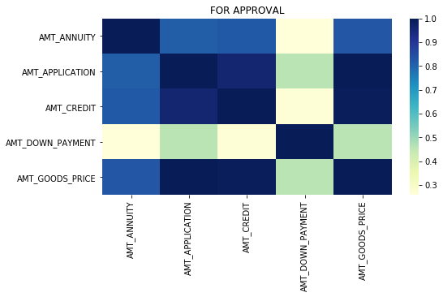
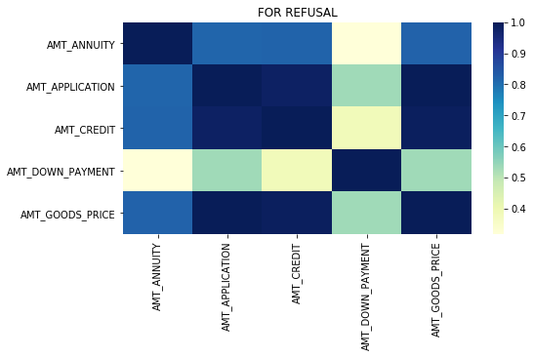
Correlation Analysis for Previous Application Data:
From the correlation tables and heat map we can clearly see that correlation between the variables is same for both the data frames approval application and refused application. The correlation between the variables chosen is positive. The correlation between AMT_CREDIT and AMT_ANNUITY is very where as AMT_DOWN_PAYMENT and AMT_CREDIT is not so well.

Slide 11
Conclusion and Recommendation
Banks should focus more on businessman, working type individual and students for the loan. We have also seen that the person above 30 are more likely to [pay loan on time.
Bank should not consider the loan for which the purpose is not mentioned. Also the repair purpose loans should not be considered by the bank.
Bank should avoid providing loans co op apartment clients as they came under defaulter category most of the time.
Bank should consider clients who owns a house or apartment as they pay the annuity on time.
Bank should also consider the whether an old client payed all the installments on time or not while providing the new loan.

Slide 12
THANK YOU

